Slide 1
Introduction & Troubleshooting with IBM Daeja Viewer
Daeja L2 support engineer:
Ada & Yuki

Slide 2
Content
  1. The purpose of this presentation
  2. Basic information
  3. Troubleshooting
    3.1 Troubleshoot with Displaying issues
    3.2 Troubleshoot with Annotation issues
    3.3 Troubleshoot with Performance issues
  4. Support and Assistance
  5. Further information
  6. Questions and Answers

Slide 3
1. The purpose of this presentation
After this course you will be able to:
Better understanding of IBM Daeja Viewer product
Self troubleshooting with some common issues
  Displaying issues
  Annotation issues
  Performance issues
Better get IBM support services

Slide 4
2. Basic information - Architecture
Client side
Server side
Browser
Document retrieval component
Document Repository
Viewer
Annotation save\retrievalcomponent
Annotation Data

Slide 5

2. Base information - Main Types
ViewONE Standard (IS, P8)
  TIFF, GIF, JPEG,BMP, PNG, COLD file types
  Annotations
  Print Accelerator
  Basic Viewer
ViewONE Pro (PIE, ICN)
  ViewONE Standard plus:
  ACM (Advance Cache Manager)
  PDF Viewing
  Office document Viewing
  Universal Viewing (300+ formats)
  Document Streaming

Slide 6
Content
  1. The purpose of this presentation
  2. Basic information
  3. Troubleshooting
    3.1 Troubleshoot with Displaying issues
    3.2 Troubleshoot with Annotation issues
    3.3 Troubleshoot with Performance issues
  4. Support and Assistance
  5. Further information
  6. Questions and Answers

Slide 7
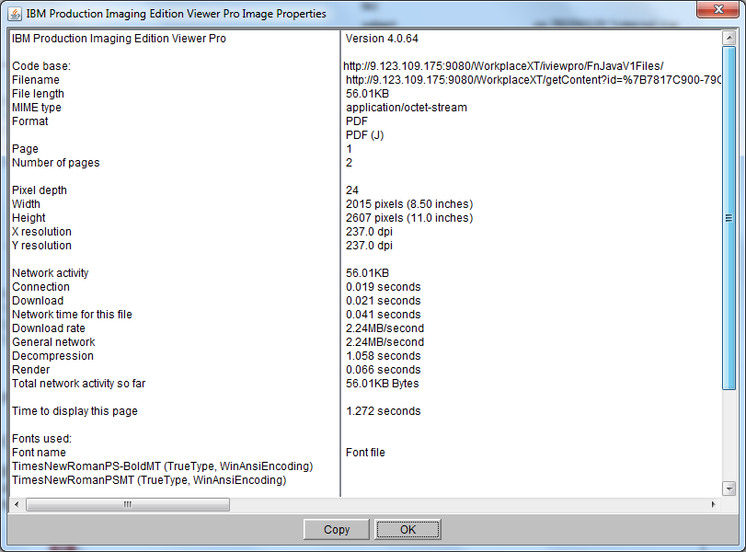
2. Base information - information collecting for image properties
Press shift+I in viewer

Slide 8
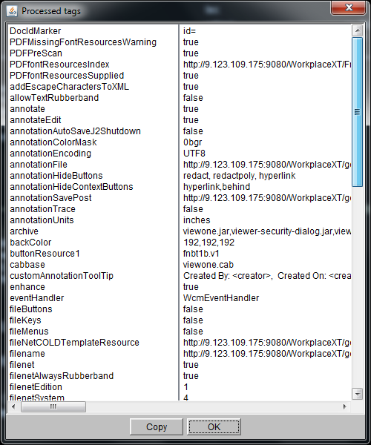
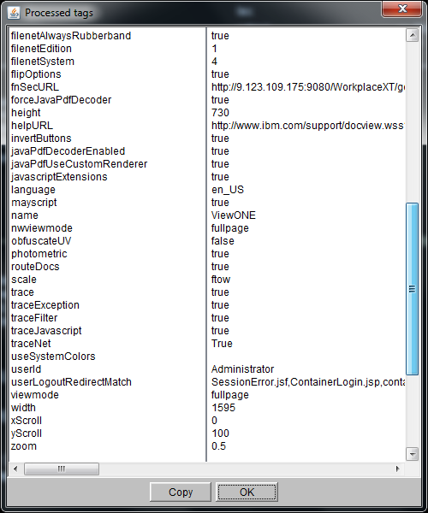
2. Base information - information collecting for processed parameters
Press shift+t

Slide 9
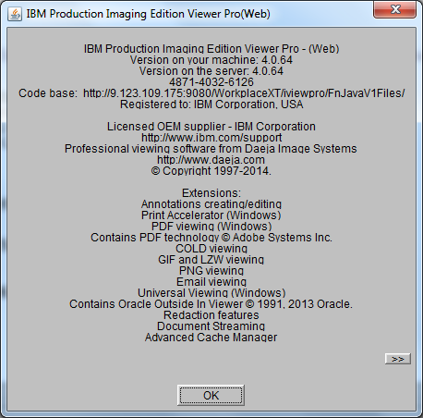
2. Base information - information collecting for version&module details
Clicking on the ViewONE logo (non-IBM systems)
Right hand click menu and "Help" ->“About” menu

Slide 10
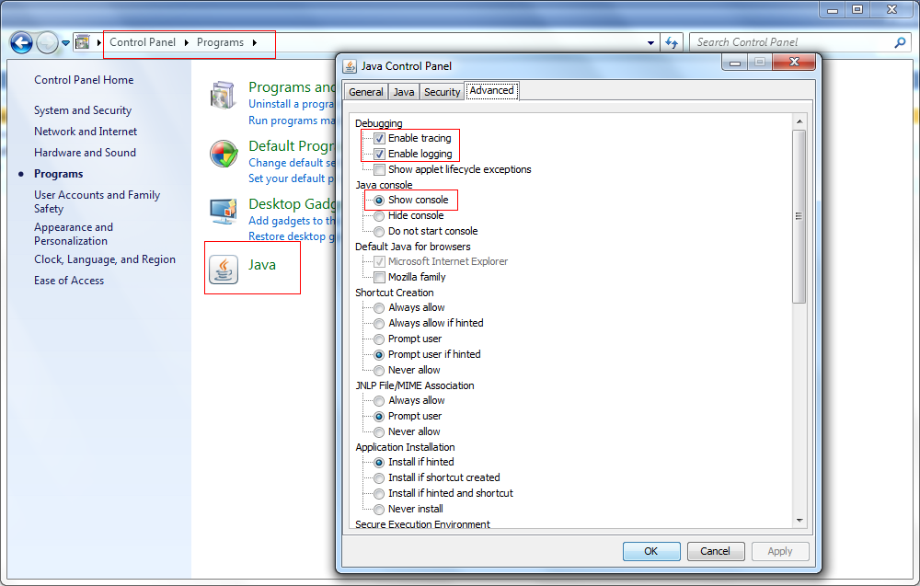
2. Base information - information collecting for java console
Enable java console

Slide 11
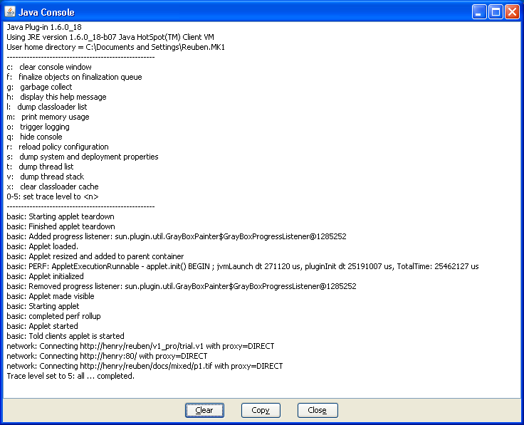
2. Base information - information collecting for java console
Clicking on the Java console and hitting "5"

Slide 12
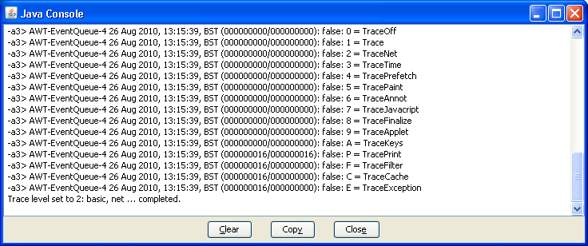
2. Base information - information collecting for java console
Press shift+ctrl+t

Slide 13
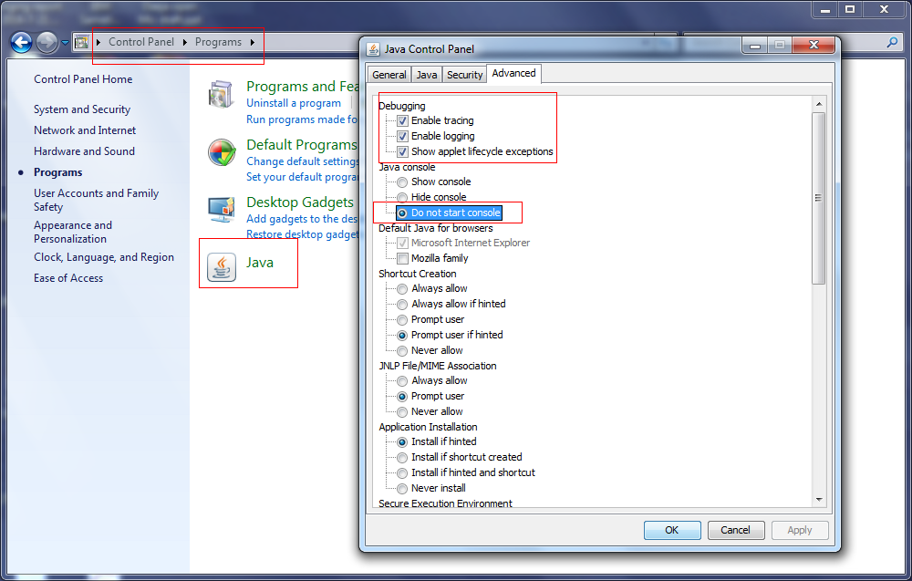
2. Base information - information collecting for java console
Collecting logs in background
C:\Users\<user>AppData\LocalLow\Sun\Java\Deployment\log
(example from Windows 7 machine)

Slide 14
2. Base information - Key Shortcuts
<Shift> H Show image properties
<Shift> Q Show cache location
<Ctrl> T Show control codes in loaded text file
<Shift> I Show ACM location on locally installed ViewONE Pro
<Shift> Y Show system information^
<Shift> T Show processed tags^
<Shift> A Show annotations
<Ctrl> D Delete all annotations*
<Shift> M Toggles Status bar to show mouse co-ordinates*
^ These can be disabled using separate HTML parameters
* Will be turned off from Build X.0.48 onwards only

Slide 15
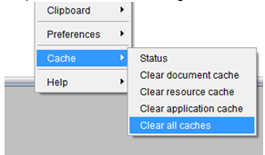
2. Base information - enable trace
Trace parameters:
  trace / traceNet / traceException / traceFilter/ traceJavascript
Steps to enable trace:
  1. Clear the current cache and restart browser.

Slide 16
2. Base information - enable trace
Trace parameters:
  trace / traceNet / traceException / traceFilter/ traceJavascript
Steps to enable trace:
  2. Add these parameters in the jsp file.
  For Workplace/XT
    Location of the jsp file "WcmJavaViewer.jsp".
    \\WebSphere\AppServer\profiles\AppSrv01\installedApps\CellName\WorkplaceXT.ear\web_client.war\UI-INF\jsp\ui\iviewpro
    writeParam('trace', 'true'); // Set to true for debugging
    writeParam('traceNet', 'true');
    writeParam('traceException','true');
    writeParam('traceFilter','true');
    writeParam('traceJavascript','true');

Slide 17
2. Base information - enable trace
Trace parameters:
  trace / traceNet / traceException / traceFilter/ traceJavascript
Steps to enable trace:
  2. Add following parameters in the jsp or js file.
  For IBM Content Navigator
    Location of the jsp file "filenetViewer_propertes.jsp".
    \\WebSphere\AppServer\profiles\AppSrvAPP\installedApps\CellName\navigator.ear\navigator.war\applets
    trace: "true",
    traceNet: "true",
    traceException: 'true",
    traceFilter: "true",
    traceJavascript: "true",

Slide 18
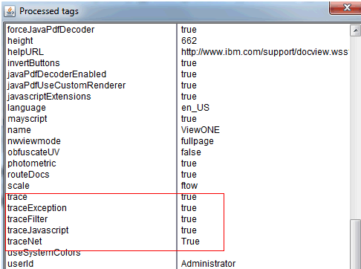
2. Base information - enable trace
Trace parameters:
  trace / traceNet / traceException / traceFilter/ traceJavascript
Steps to enable trace:
  3. Sava the file, don't need to restart the server.
  4. Verify. Shift+T and check trace value is "true".

Slide 19
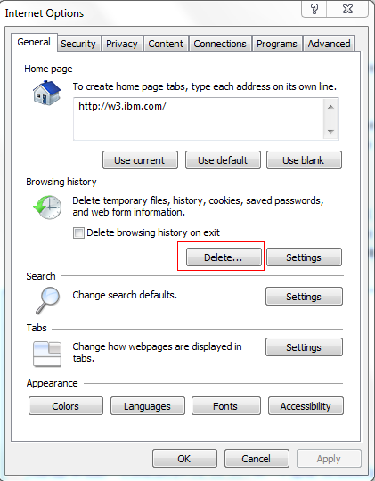
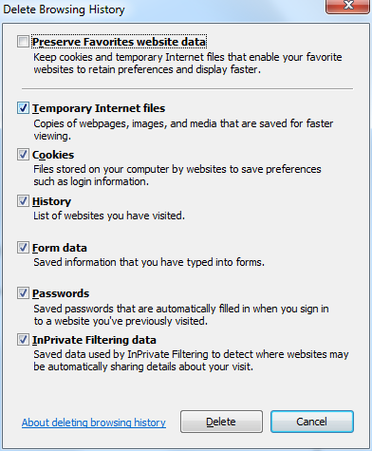
2. Base information - clearing cache
Delete the browser cache

Slide 20
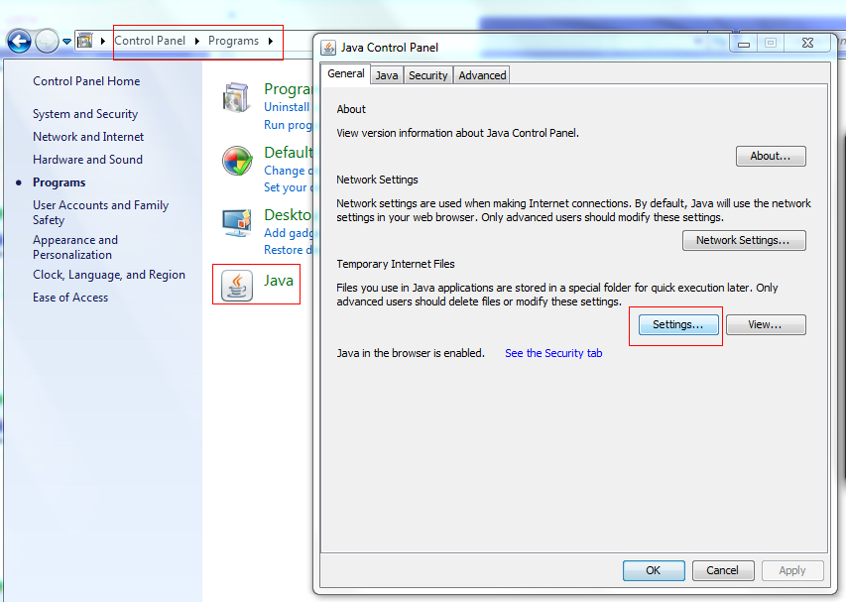
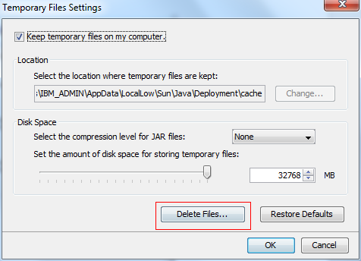
2. Base information - clearing cache
Delete the java cache

Slide 21
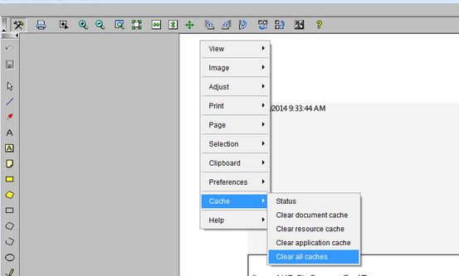
2. Base information - clearing cache
Delete the ViewONE working folder

Slide 22
Introduction
Overview
  1. The purpose of this presentation
  2. Basic information
  3. Troubleshooting
    3.1 Troubleshoot with Displaying issues
    3.2 Troubleshoot with Annotation issues
    3.3 Troubleshoot with Performance issues
  4. Support and Assistance
  5. Further information
  6. Questions and Answers

Slide 23
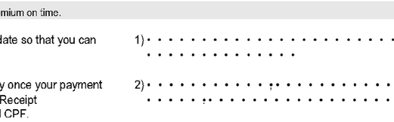
3. Troubleshooting
Displaying issue--PDFs containing some Chinese Characters inside it can't be displayed correctlly.
Description: PDFs containing some Chinese Characters inside it can't be displayed correctlly.
Symptom: Open the PDFs in IBM Daeja ViewONE Pro:English is displayed well but Chinese characters are displayed as dots.
Environment: IBM Daeja ViewONE Pro 4.0.X

Slide 24
3. Troubleshooting
Displaying issue--PDFs containing some Chinese Characters inside it can't be displayed correctlly.
Troubleshooting:
  Step1: Something special to this file?
Conlusion：
  We have reason to doubt it's font related issue.
Normal files
1) Other Types: wicrosoft office,tiff,jpeg...
2) PDF:Other PDFS without Chinese charaters
All work well

Slide 25
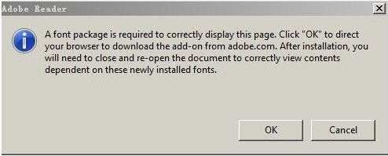
3. Troubleshooting
Displaying issue--PDFs containing some Chinese Characters inside it can't be displayed correctlly.
Troubleshooting:
  Step2: Narrow down the root cause--File's issue or Daeja Viewer Defect
    Only PDFs with Chinese Characters have the issue in IBM Daeja Viewer.
  How about it in Adobe Reader?

Slide 26
3. Troubleshooting
Displaying issue--Document can't be loaded when streamer is enabled in Content Navigator.
  Symptom: Unable to open any PDF in IBM daeja viewer when streamer is enabled
  Environment: IBM Content Navigator 2.0.2 & IBM Daeja ViewONE Pro 4.0. X
Troubleshooting:
  1. What kinds of files have the issue?
    PDF/ Tiff -> Can't be opened in viewer.
    Jpeg/gif/jpg -> Can be opened in viewer.
    txt -> Can be opened by browser.
Consolusion:
  Except txt files, other types of files are opened by daeja viewer by default.
    Jpeg/gif/jpg types files can be opened -> Daeja works
    PDF/ Tiff types can't be opened -> We doubt it's streamer related issue.

Slide 27
3. Troubleshooting
Displaying issue--Document can't be loaded when streamer is enabled in Content Navigator.
Troubleshooting.
  2. Verify our doubt
    1)Besides ICN, Workplace/ XT can also open PDF/Tiff using ViewONE pro.
      Test with Workplace/XT-> All can be opened
    2)Online demo
      Test with PDF/Tiff -> All can be opened.
Consolusion:
  Except ICN, all others don't contain streamer. So it's more reasonable to doubt it's a streamer issue.

Slide 28
3. Troubleshooting
Displaying issue--Document can't be loaded when streamer is enabled in Content Navigator.
Troubleshooting.
  3. Disable streamer in filenetViewer.js file under ICN deployed folder
    Localtion: [ICN deployed folder]\navigator.ear\navigator.war\js
    Comment following record out:
    [ this.useStreamer = (contentType.indexOf("tiff") != -1 || contentType.indexOf("pdf") != -1); ]

Slide 29
3. Troubleshooting
Displaying issue--Document can't be loaded when streamer is enabled in Content Navigator.
Troubleshooting:
  4. Clear cache and test
    PDF/Tiff can be opened in ICN when the streamer is disabled.
Conclusion:
  This is a Streamer related issue.
Workaround:
  Disable Streamer

Slide 30
3. Troubleshooting
Displaying issue--Document can't be loaded when streamer is enabled in Content Navigator.
Troubleshooting.
  Streamer : processes both multi-page TIFFs and multi-page PDFs
Streamer impact:
  In the case of PDF files, the Streamer reduces the amount of network traffic by performing (patent-pending) optimisation of PDF information. This can have a significant impact by saving up to 50% in network activity.
  The Streamer is designed to minimise load on the server in order to be truly scaleable for even the largest of user groups.
  The Streamer also encrypts all data it sends to the client machine, so adds an additional level of security for any documents sent to the client machine via the Streamer.

Slide 31
3. Troubleshooting
Displaying issue--Document can't be loaded when streamer is enabled in Content Navigator.
Troubleshooting.
  In order to reduce the impcat of disable streamer, we have fixed it in IBM Daeja ViewONE 4.1.1.
Fix information:
  APAR : IO21681
Fix Central: http://www-933.ibm.com/support/fixcentral/

Slide 32
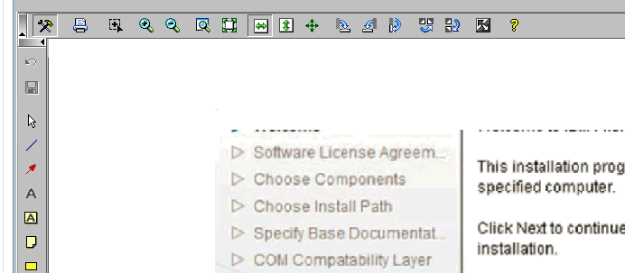
3. Troubleshooting
Displaying issue - Content of the PDF file is not displayed clearly as it is in Adobe Reader.
Symptom: Content of the PDF file is not displayed clearly as it is in Adobe Reader.
Environment: IBM Daeja ViewONE Pro 4.0. X

Slide 33
3. Troubleshooting
Displaying issue - Content of the PDF file is not displayed clearly as it is in Adobe Reader.
Symptom: Content of the PDF file is not displayed clearly as it is in Adobe Reader.
Troubleshooting.
  1. Is it any special files related?
    Open it in Adoer Reader, the content is displayed clearly.
Conclusion:
  Everything with this file is good. It's not file itself issue.

Slide 34
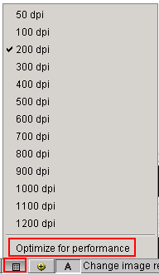
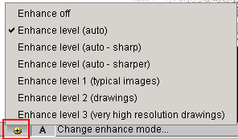
3. Troubleshooting
Displaying issue - Content of the PDF file is not displayed clearly as it is in Adobe Reader.
Troubleshooting:
  2. Is there any parameters can tune the displaying?
    DPI & Enhance model

Slide 35
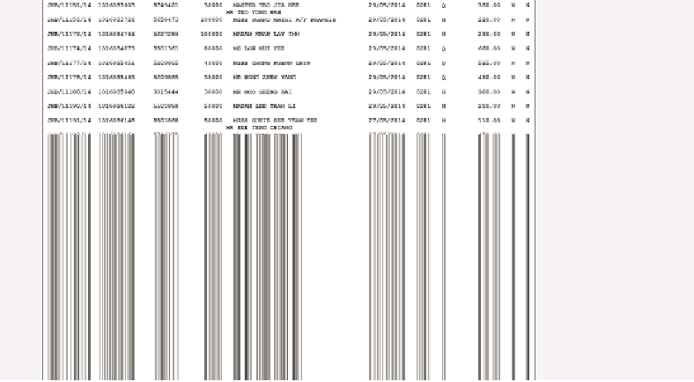
3. Troubleshooting
Dispalying issue - Text display partly
Description: Text Documents are not loading completely in viewer.
Symptom: Viewer is not loading the text file completely. It opens the content partly and remaining content is not showed. While if zoom it out, it will show the full content.
Environment: IBM Daeja ViewONE Pro 4.0.X

Slide 36
3. Troubleshooting
Dispalying issue - Text display partly
Troubleshooting:
  step 1. Is the problem showing for only certain types of documents?
Format
Character
Annotation
PDF？
TXT？
JPG？
Non-Latin
Unicode
Large text
How many？
How about deleting annotations？
Txt document+Large Text+no annotation

Slide 37
3. Troubleshooting
Dispalying issue - Text display partly
Troubleshooting:
  Step2: Do some test
    1. Simple text document
    2. Test other Large text document
    3. Compare working document and not working document
    4. Modify problematic document
  In this case:
    1. Work fine
    2. Failed
    3. Less text
    4. Will work fine after reduce the word in each row

Slide 38
3. Troubleshooting
Dispalying issue - Text display partly
Troubleshooting:
  Step3: Find the solution
Caused by:
  The default configuration for viewing text files does not support more than a page of text. The viewer parameters cited will help format the rendering of text files so that larger files may be viewed.
  textFilterWrapping <PARAM NAME="textFilterWrapping" value="true">
  textFilterPageBreaks <PARAM NAME="textFilterPageBreaks" value="true">
  textFilterPageHeight <PARAM NAME="textFilterPageHeight" value="<N>
  textFilterPageWidth <PARAM NAME="textFilterPageWidth" value="<N>">

Slide 39
Introduction
Overview
  1. The purpose of this presentation
  2. Basic information
  3. Troubleshooting
    3.1 Troubleshoot with Displaying issues
    3.2 Troubleshoot with Annotation issues
    3.3 Troubleshoot with Performance issues
  4. Support and Assistance
  5. Further information
  6. Questions and Answers

Slide 40
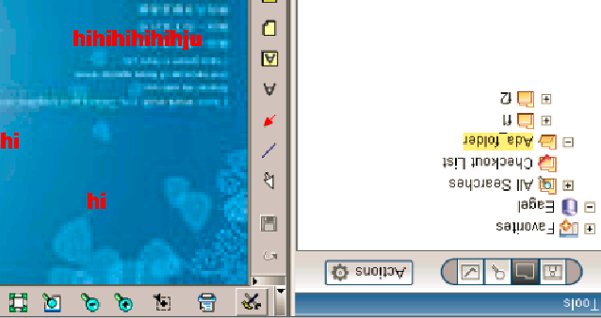
3. Troubleshooting
Annotation issue--Rotate/Print files or annotations for your specific requirement by some customers
Specifical requirement:
  A) Rotate files before any annotations.

Slide 41

3. Troubleshooting
Annotation issue--Rotate/Print files or annotations for your specific requirement by some parameters
Specifical requirement:
  A) Rotate files before any annotations.
Parameter: allowAnnotationRotationOnTags
  Value = “false” means the image will be rotated before the annotations are applied to the image-----the actual image data itself is rotated.
  Value = "true" means image is rotated after the annotation is applied. Annotation data will therefore be rotated with the image.-----Equal to clicking the rotate image button.

Slide 42
3. Troubleshooting
Annotation issue--Rotate/Print files or annotations for your specific requirement by some parameters
Specifical requirement:
  B) Save the rotation of image
  After you rotation image from upside-down to right way up, you need to save the rotation. So next time you open it, it will be displayed normally for reading.
Parameter: filenetSaveImageRotation
  It's the FileNet-only parameter. Set its value to "true".

Slide 43
3. Troubleshooting
Annotation issue--Rotate/Print files or annotations for your specific requirement by some parameters
How to set above parameters:
  Step 1. Stop the Application Server
  Step 2. Adding these parameters in the WcmJavaViewer.jsp file in the deployed location (e.g.: ..\Workplace\UI-INF\jsp\ui).
    <%-- Note: The following list provides configuration parameters for the
    Image Viewer.Many of these parameters are necessary for P8 to function normally. Please do not modify any of the FileNet parameters. I've added comments to point out these parameters. --%>
  writeParam('allowAnnotationRotationOnTags','true');
  writeParam('filenetSaveImageRotation','true');

Slide 44
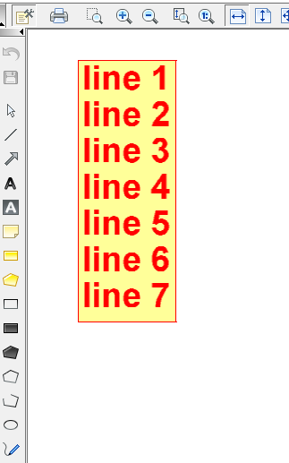
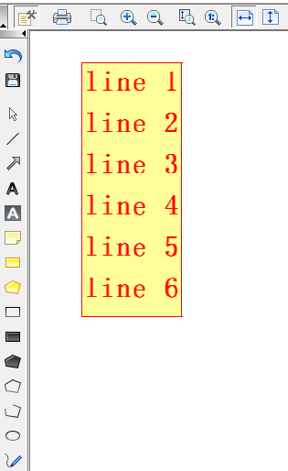
3. Troubleshooting
Annotation issue - annotation can't be displayed completely
Description: Annotation text can't display completely
Symptom: When you create a annotaion with English locale, it will partial dispaly in Chinese locale.
Environment: IBM Daeja ViewONE Pro 4.0.X

Slide 45
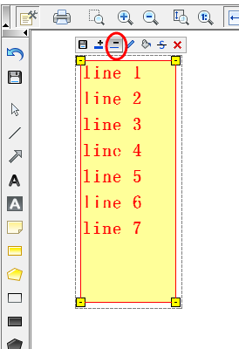
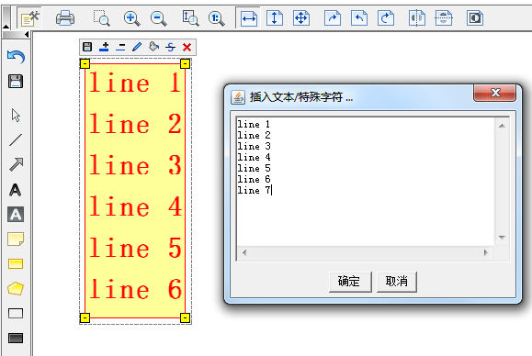
3. Troubleshooting
Annotation issue - annotation can't display completely
Troubleshooting:
  step 1. Words get missed or invisible?
Format
Character
Words are invisible

Slide 46
3. Troubleshooting
Annotation issue - annotation can't display completely
Troubleshooting:
  Step2: Find the solution
Caused by:
  Text will use different font styles in English locale and Chinese locale. It is Java that finally controls this behavior. Need to stop viewer from allowing text annotations to be resized.
  allowTextRubberband
  <PARAM NAME="allowTextRubberband" value="false ">

Slide 47
3. Troubleshooting
Annotation issue--Rotate/Print files or annotations for your specific requirement by some parameters
How to set above parameters:
  Step 3. Save the file and restart the Application Server.
  Step 4. Clear out all the Cache.
  Step 5. Open a new Browser

Slide 48
Introduction
Overview
  1. The purpose of this presentation
  2. Basic information
  3. Troubleshooting
    3.1 Troubleshoot with Displaying issues
    3.2 Troubleshoot with Annotation issues
    3.3 Troubleshoot with Performance issues
  4. Support and Assistance
  5. Further information
  6. Questions and Answers

Slide 49
3. Troubleshooting
Performance issue-- Three areas which probably have performance issues
Startup
Document retrieval
Decompression and rendering

Slide 50
3. Troubleshooting
Performance issue-- How to improve performance
  Advanced Cache Manager (ACM)
    Reduce the download time, ACM downloads and cache required viewer components
  Pre-initialization of browser,JRE and/or applet
    Put the applet tag which loads the viewer on a login page or other page will force the viewer to load and initialize JRE in the back ground before it is required by a user.
  Using JavaScript to remove startup delays
    Starting applets and shutting them down can be resource hungry and time intensive. Using JavaScript to manage viewer instance can avoid repeat startup and shut down.
  ViewONE Pro is designed to store each page separately
    So if multi-page documents are being viewed, the only required page by users can be retrieved using Page<N> parameter or the Document Streaming Server Module.

Slide 51
3. Troubleshooting
Performance issue-- How to improve performance
  Prefetching
    Pre-fetch any number of pages ahead of where the user is currently viewing, effectively utilizes ‘dead-time’ while the user is busy reading a particular page.
  Separate thumbnails
    the viewer must retrieve the main image files first, pre-generated thumbnail files are usually much smaller than the source image file, it will reduce display time.
  Text index alternative to thumbnails
    Text index is basically an array of text lines with page numbers, and which in terms of retrieval is usually a considerably smaller amount of data than thumbnail or image data.

Slide 52
4. Support and assistance
1. Buy Daeja entitlement
2. Ways to create PMRs:
  SR Tool(http://www.ibm.com/support/servicerequest) (Recommend)
  IBM hot line (http://www.ibm.com/planetwide/)
3. create PMRs and route to queue FNCM,43
  5725Q0200 Daeja ViewONE Standard 4.0.x
  5725Q0300 Daeja ViewONE Professional 4.0.x

Slide 53
5. Further information
1. Legacy Daeja documentation (covers all releases until 4.1.0.0)
  http://www-01.ibm.com/support/docview.wss?uid=swg21667122
2. ViewONE 4.1.0 (Blue washed) documentation (covers 4.1.0.0+)
  http://www-01.ibm.com/support/docview.wss?uid=swg27041437
3. Daeja ViewONE Release Notes
  http://www-01.ibm.com/support/docview.wss?uid=swg27042336
4. FAQs about the transition of Support from Daeja Systems to IBM
  http://www-01.ibm.com/support/docview.wss?uid=swg21669058
5. Download demo & online demo
  http://www-01.ibm.com/software/info/daeja/

Slide 54

Q&A

Slide 55

The end of this session
Thank You！

